Slide 1
Chapter 9 Objects and Classes

Slide 2
Listings 9.6 & 9.7
Pages 340-1
CircleWithStaticMembers.java
TestCircleWithStaticMembers.java

Slide 3
Static Variables, Constants, and Methods
Static variables are shared by all the instances of the class.
Static methods are not tied to a specific object.
Static constants are final variables shared by all the instances of the class.

Slide 4
Static Variables, Constants, and Methods, cont.
To declare static variables, constants, and methods, use the static modifier.

Slide 5
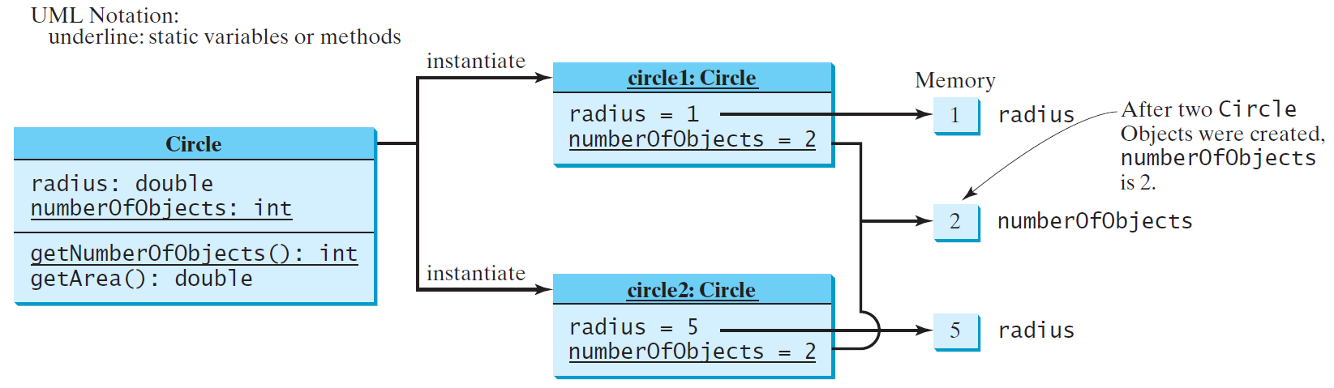
Static Variables, Constants, and Methods, cont.

Slide 6
Listings 9.8 & 9.9
Pages 347-8
CircleWithPrivateDataFields.java
TestCircleWithPrivateDataFields.java

Slide 7
Visibility Modifiers and
Accessor/Mutator Methods
By default, the class, variable, or method can be
accessed by any class in the same package.
public
The class, data, or method is visible to any class in any package.
private
The data or methods can be accessed only by the declaring class.
The get and set methods are used to read and modify private properties.

Slide 8

The private modifier restricts access to within a class, the default modifier restricts access to within a package, and the public modifier enables unrestricted access.

Slide 9
Why Data Fields Should Be private?
To protect data.
To make code easy to maintain.

Slide 10

Example of
Data Field Encapsulation
CircleWithPrivateDataFields
TestCircleWithPrivateDataFields
Run

